Slide 1
Scaffolding

Slide 2
Scaffolding
Controller & views genereren voor CRUD
Details
Index
Edit (GET & POST)
Create(GET & POST)
Delete(GET & POST)
Relational data

Slide 3
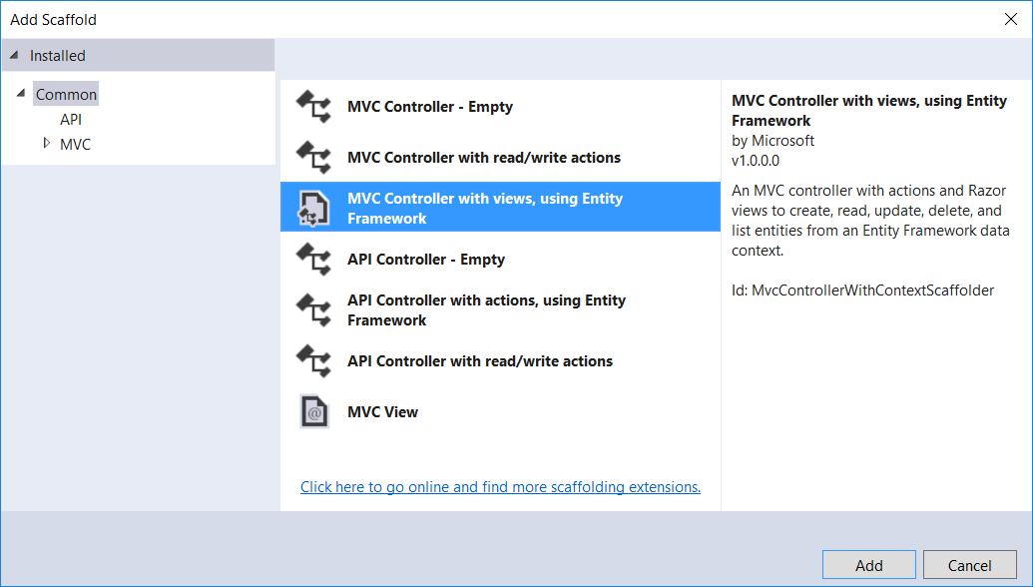
scaffolding
Controller & Views voor CRUD creëren a.h.v. de Model Class
Controllers | Add New Scaffolded Item

Slide 4
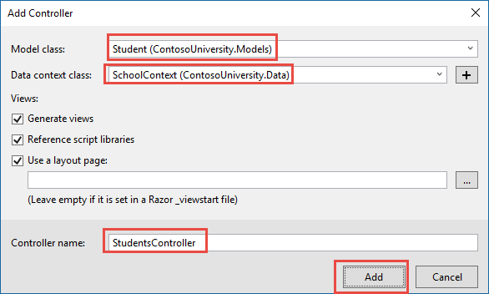
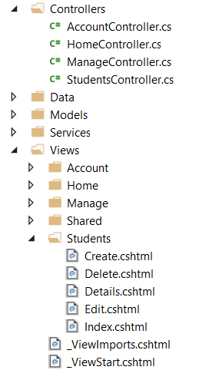
CRUD voor Student

Slide 5
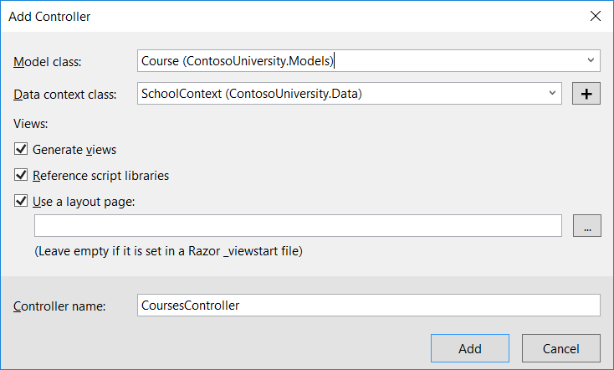
Idem voor Course & Enrollment

Slide 6
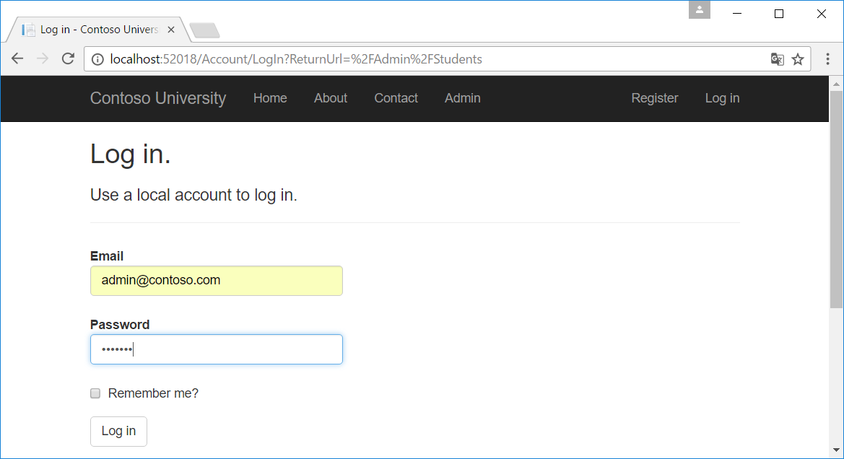
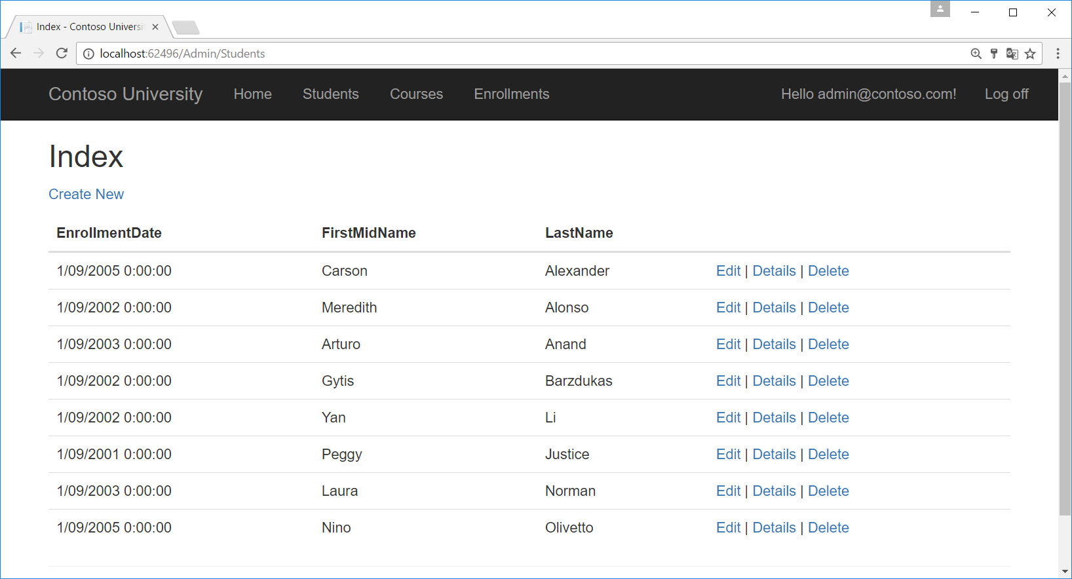
Run The Application

Slide 7
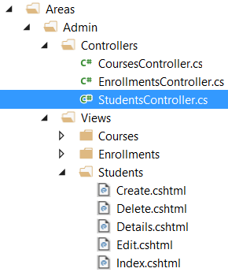
Gegenereerde code
StudentsController.cs & Students Views
Details: gegevens van één student bekijken (Get)
Index: overzicht van alle studenten (Get)
Edit
Get: gegevens van één student ophalen om te wijzigen
Post: gewijzigde gegevens wegschrijven
Create
Get: nieuwe student invullen
Post: nieuwe student aan database toevoegen
Delete
Get: bevestiging vragen
Post: student verwijderen

Slide 8
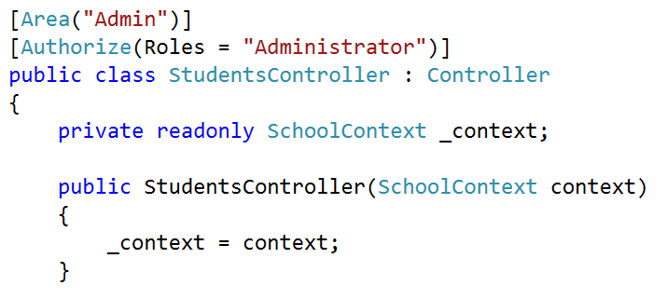
DBContext

Slide 9
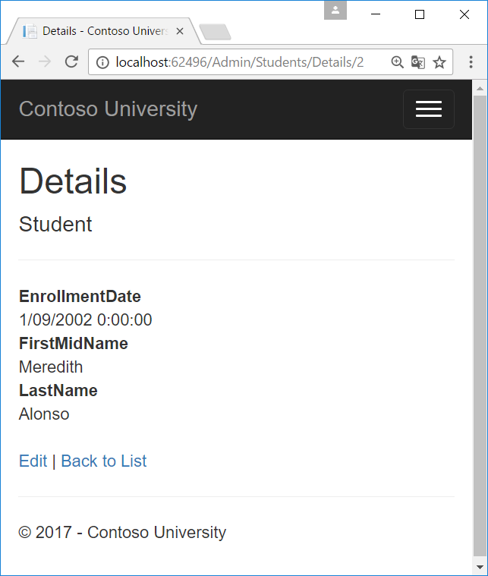
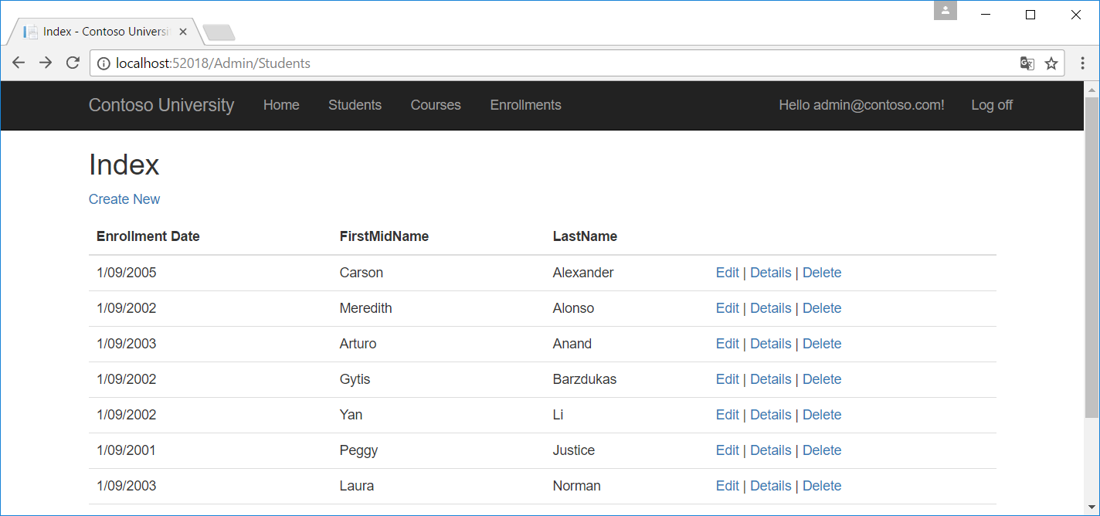
1. Details methode
Students/Details/2

Slide 10
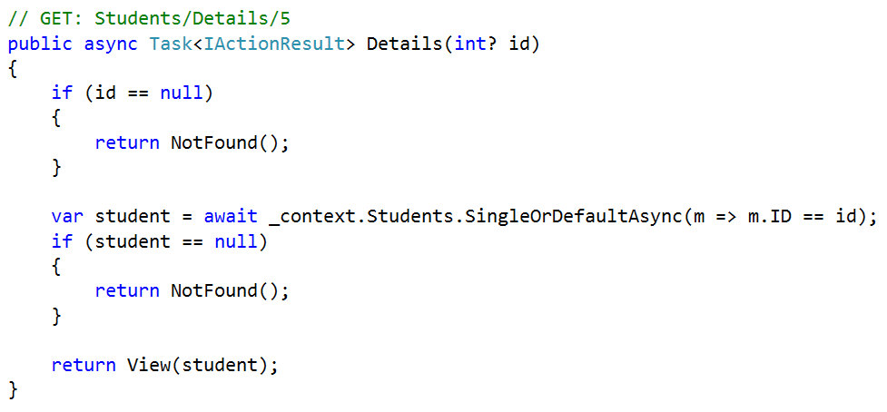
Details methode

Slide 11
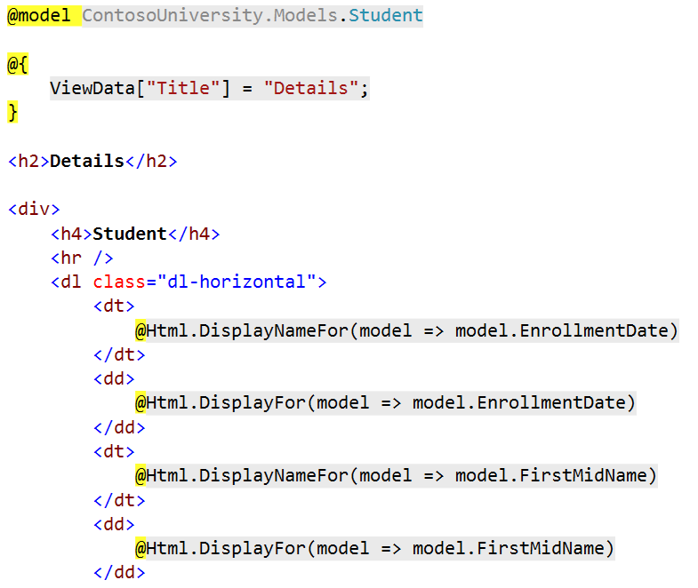
Details view

Slide 12

Data Annotations
public class Student
{
public int ID { get; set; }
public string LastName { get; set; }
public string FirstMidName { get; set; }
[Display(Name = "Enrollment Date")]
[DataType(DataType.Date)]
public DateTime EnrollmentDate { get; set; }
public ICollection<Enrollment> Enrollments { get; set; }
}

Slide 13
Async, await, Task

Slide 14
synchroon ⬄ ASynchroon
Build view
start
einde
Synchroon (1 thread)
Waiting for I/O
Request naar db
Request complete
tijd
Build view
start
einde
Asynchroon (2 threads)
Waiting for I/O
Request naar db (async)
Request complete
(await)
tijd

Slide 15
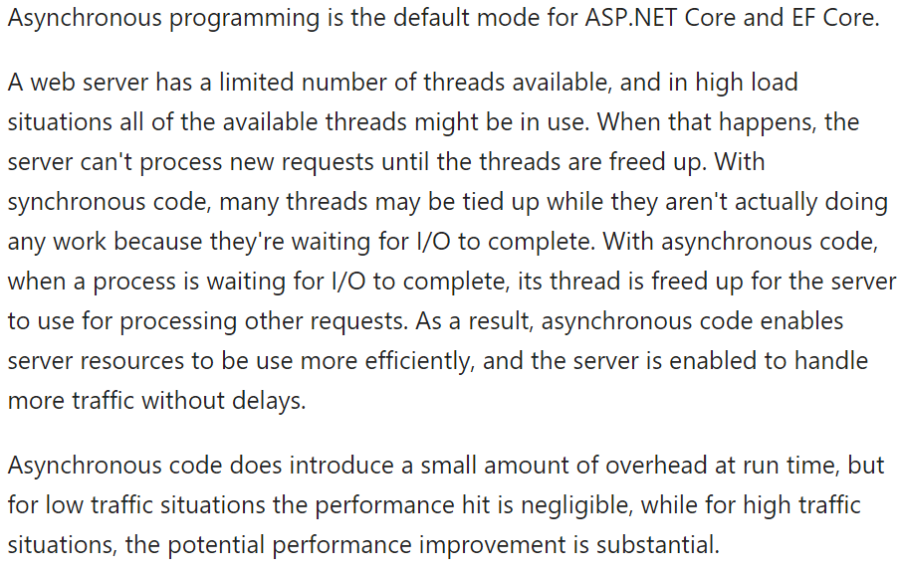
Asynchronous code

Slide 16
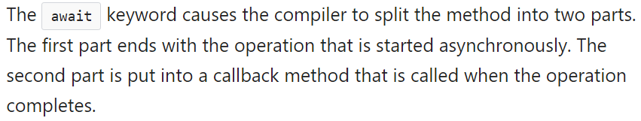
Await

Slide 17
More Info!
https://docs.microsoft.com/en-us/aspnet/mvc/overview/performance/using-asynchronous-methods-in-aspnet-mvc-4

Slide 18
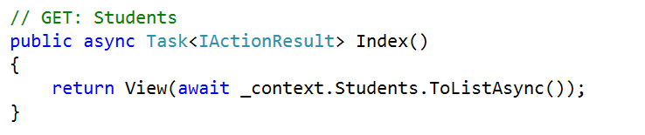
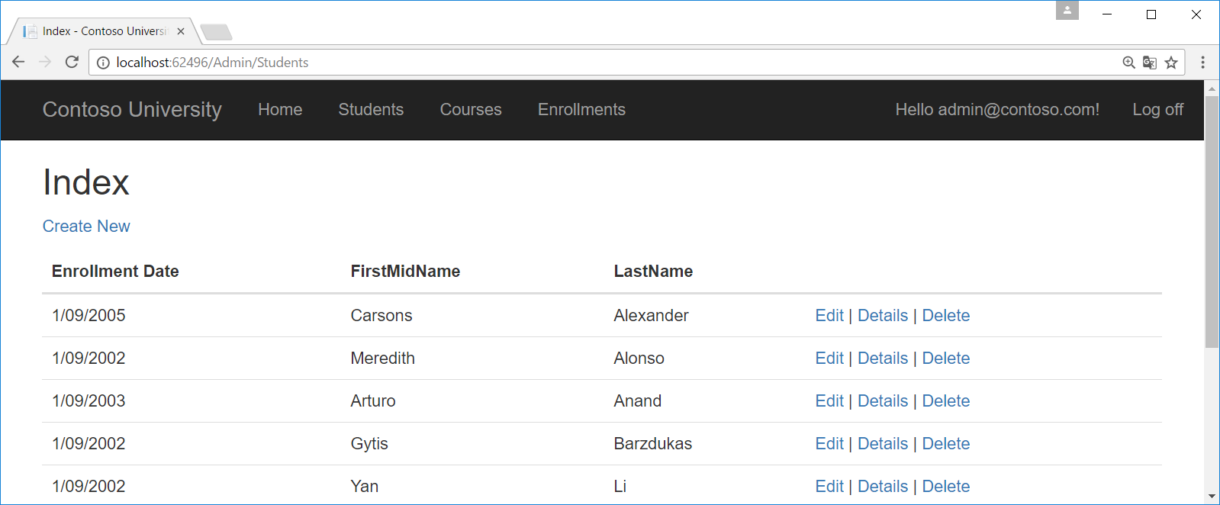
2. Index Method

Slide 19
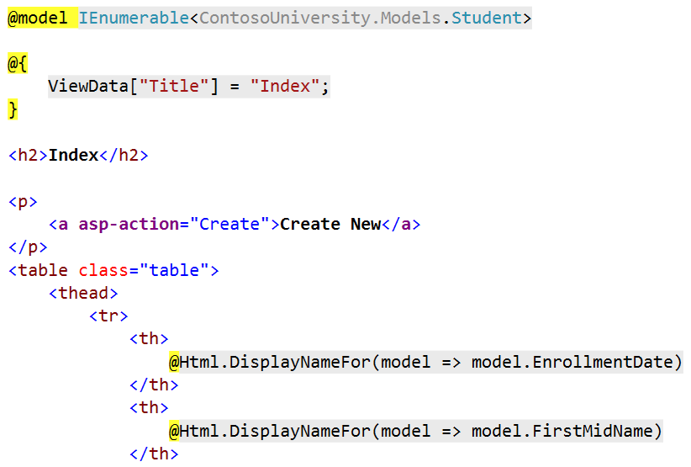
Index View

Slide 20
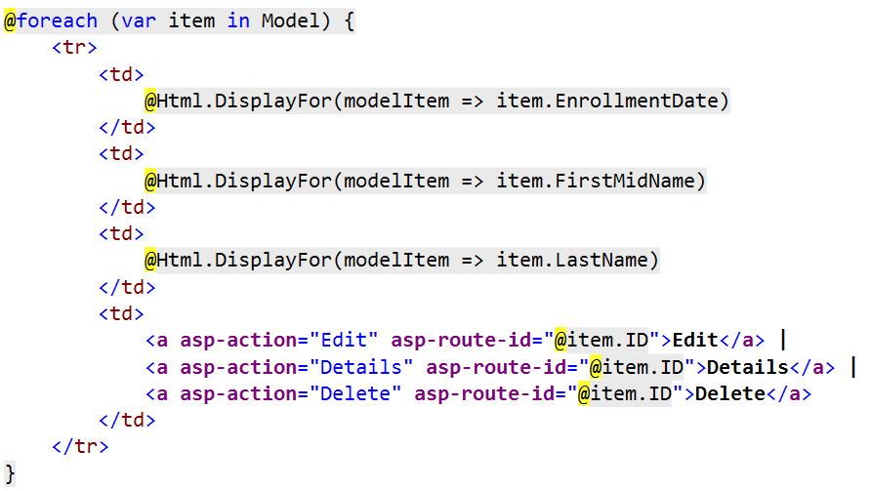
Index View

Slide 21
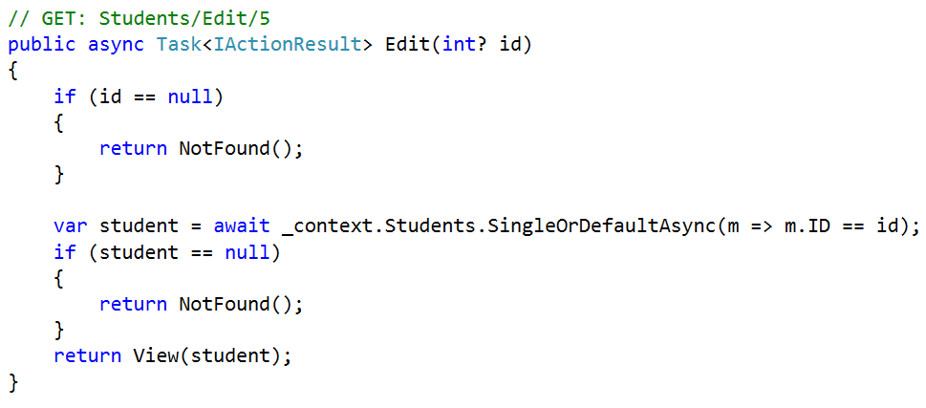
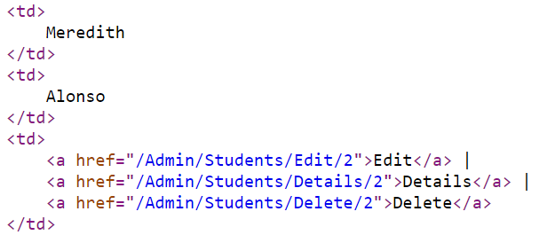
3A. Edit methode (Get)

Slide 22
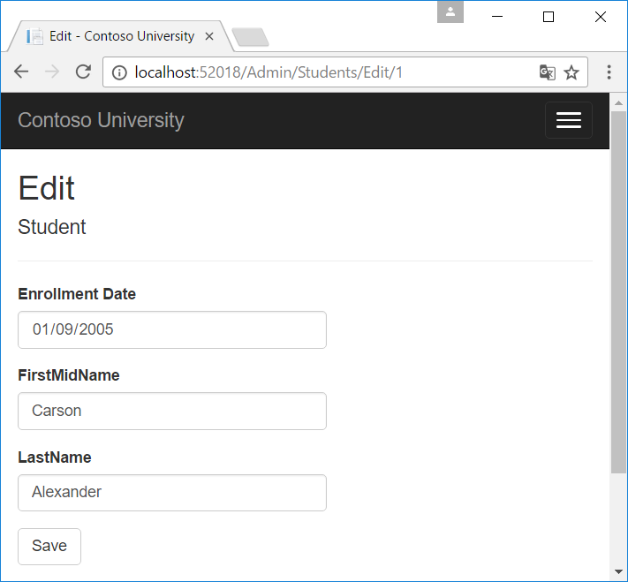
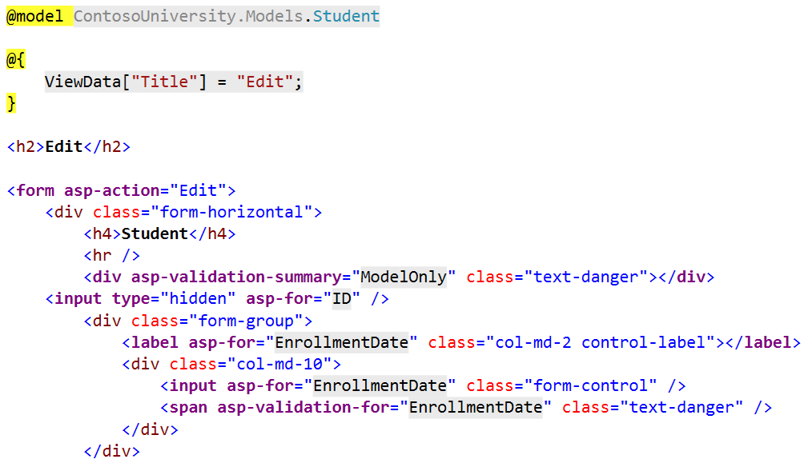
Edit View

Slide 23
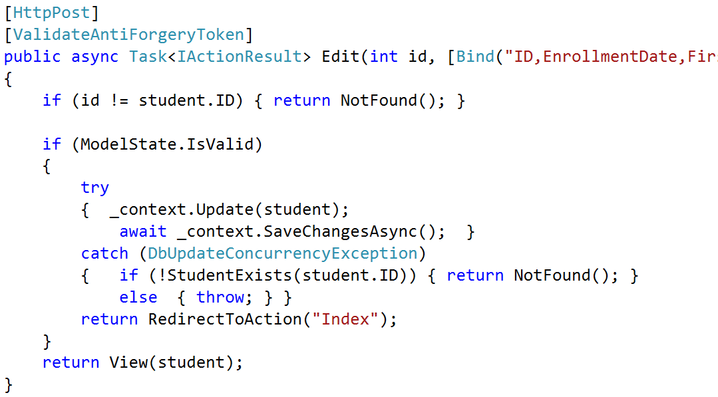
3B. Edit methode (POST)

Slide 24
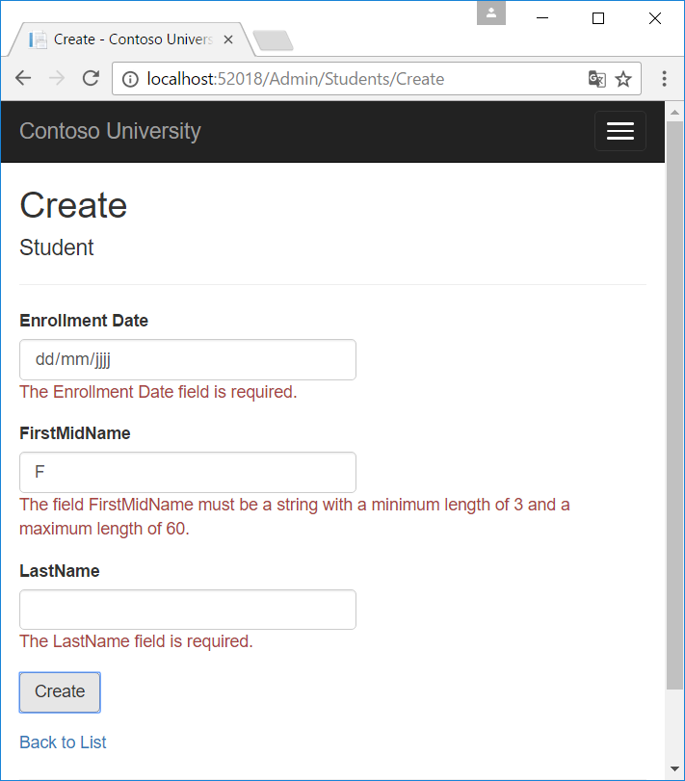
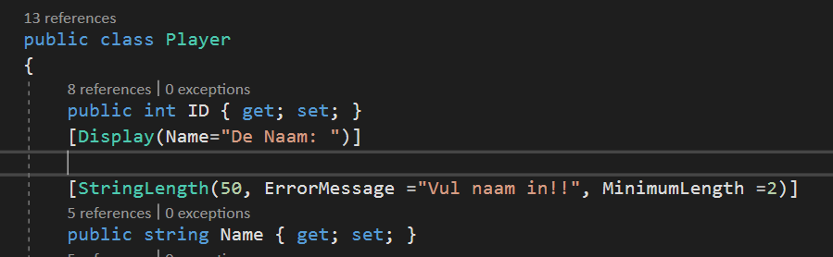
Validations
public class Student
{
public int ID { get; set; }
[StringLength(60, MinimumLength = 3)]
[Required]
public string LastName { get; set; }
[StringLength(60, MinimumLength = 3)]
[Required]
public string FirstMidName { get; set; }
[Display(Name = "Enrollment Date")]
[DataType(DataType.Date)]
public DateTime EnrollmentDate { get; set; }
public ICollection<Enrollment> Enrollments { get; set; }
}

Slide 25
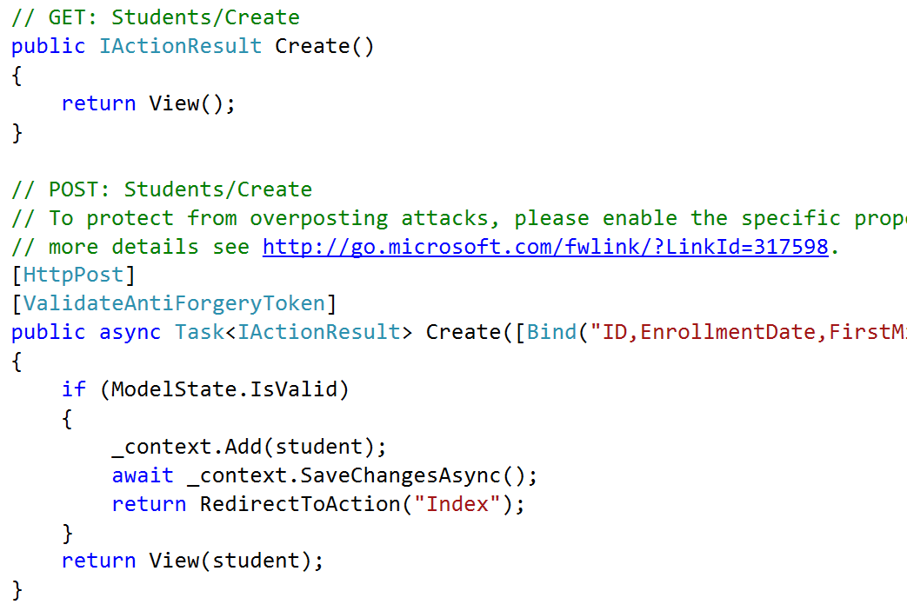
4. Create

Slide 26
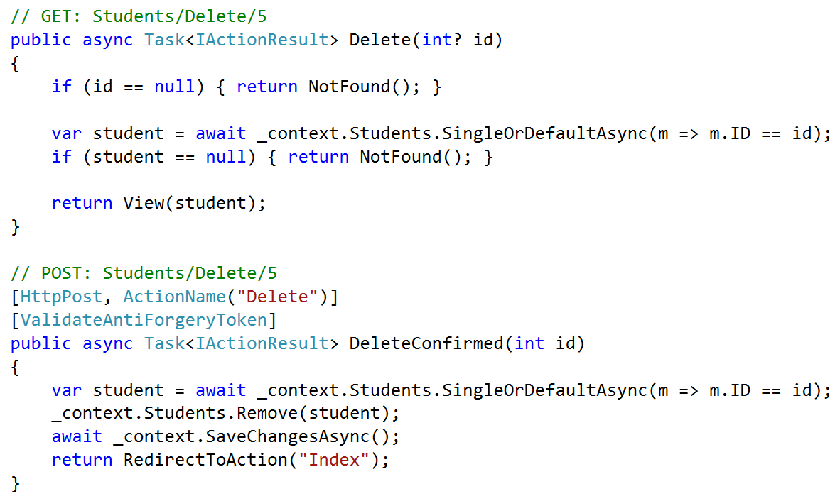
5.Delete

Slide 27
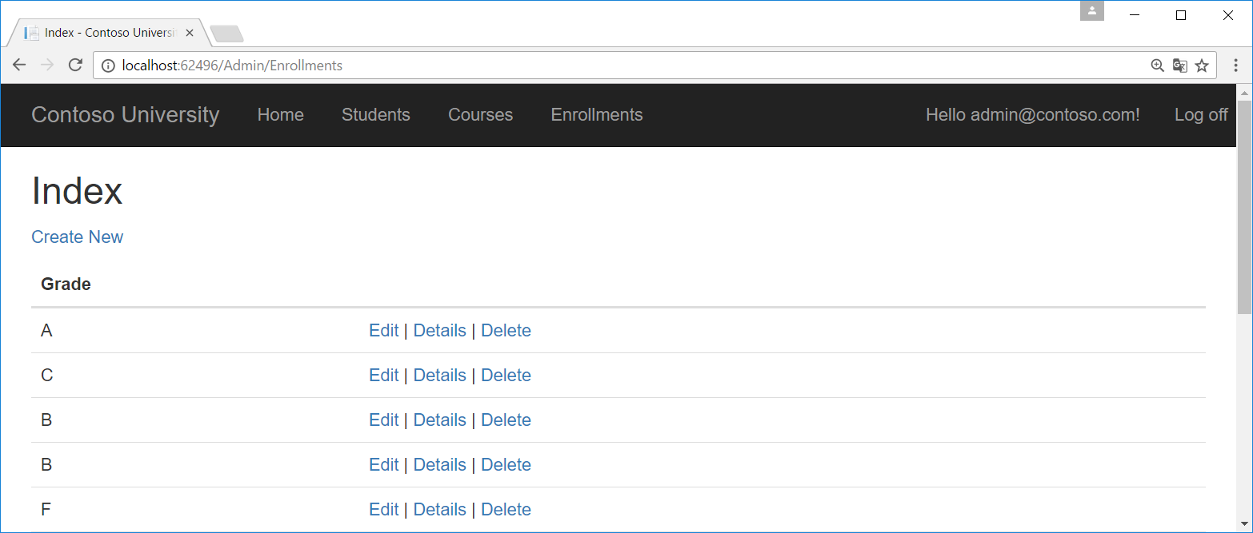
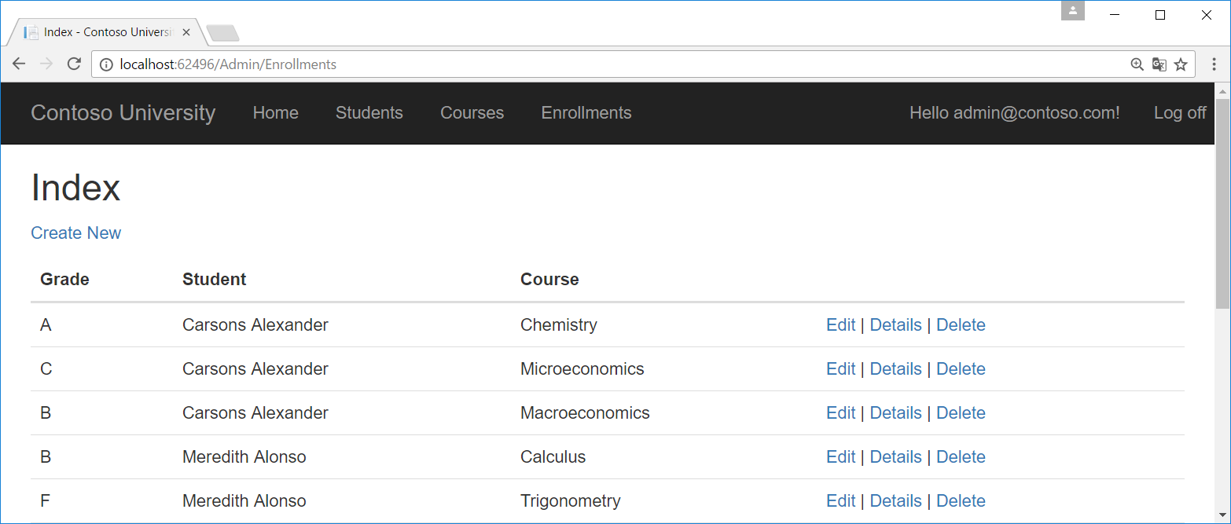
Relational data - Enrollments

Slide 28
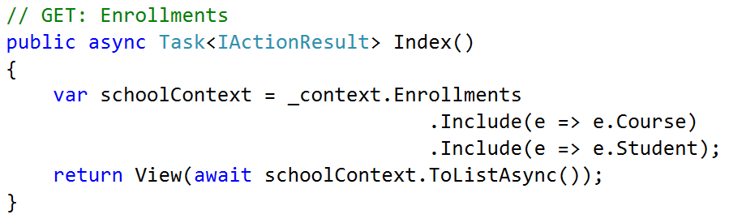
EnrollmentsController.cs

Slide 29
Index.cshtml
<th>
@Html.DisplayNameFor(model => model.Grade)
</th>
<th>
@Html.DisplayNameFor(model => model.Student)
</th>
<th>
@Html.DisplayNameFor(model => model.Course)
</th>
<td>
@Html.DisplayFor(modelItem => item.Grade)
</td>
<td>
@Html.DisplayFor(modelItem => item.Student.FirstMidName)
@Html.DisplayFor(modelItem => item.Student.LastName)
</td>
<td>
@Html.DisplayFor(modelItem => item.Course.Title)
</td>

Slide 30
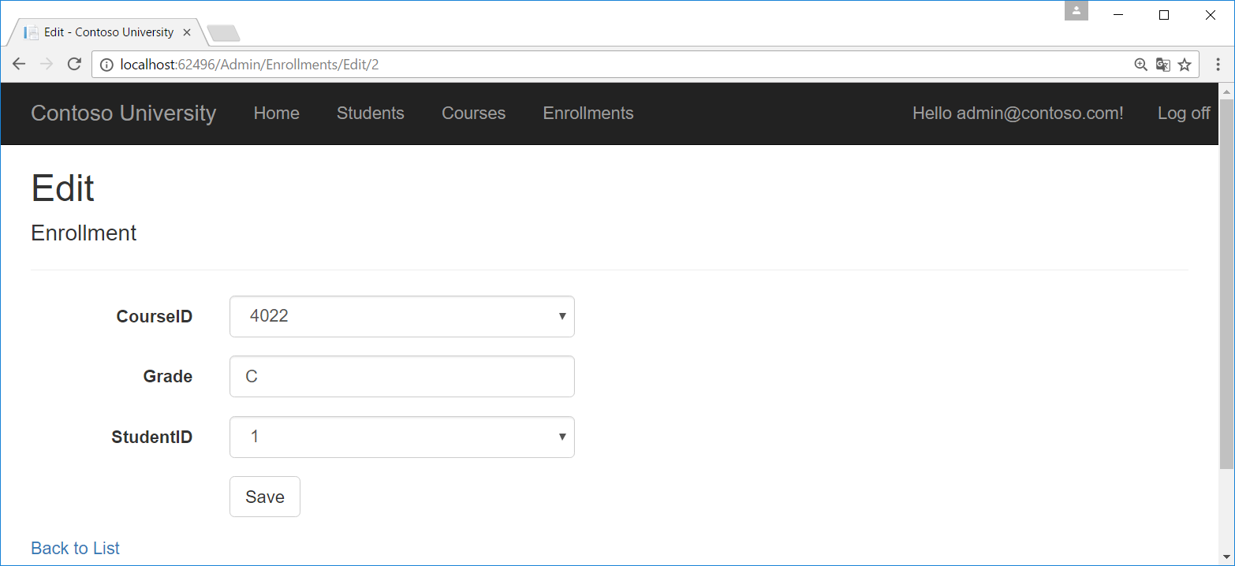
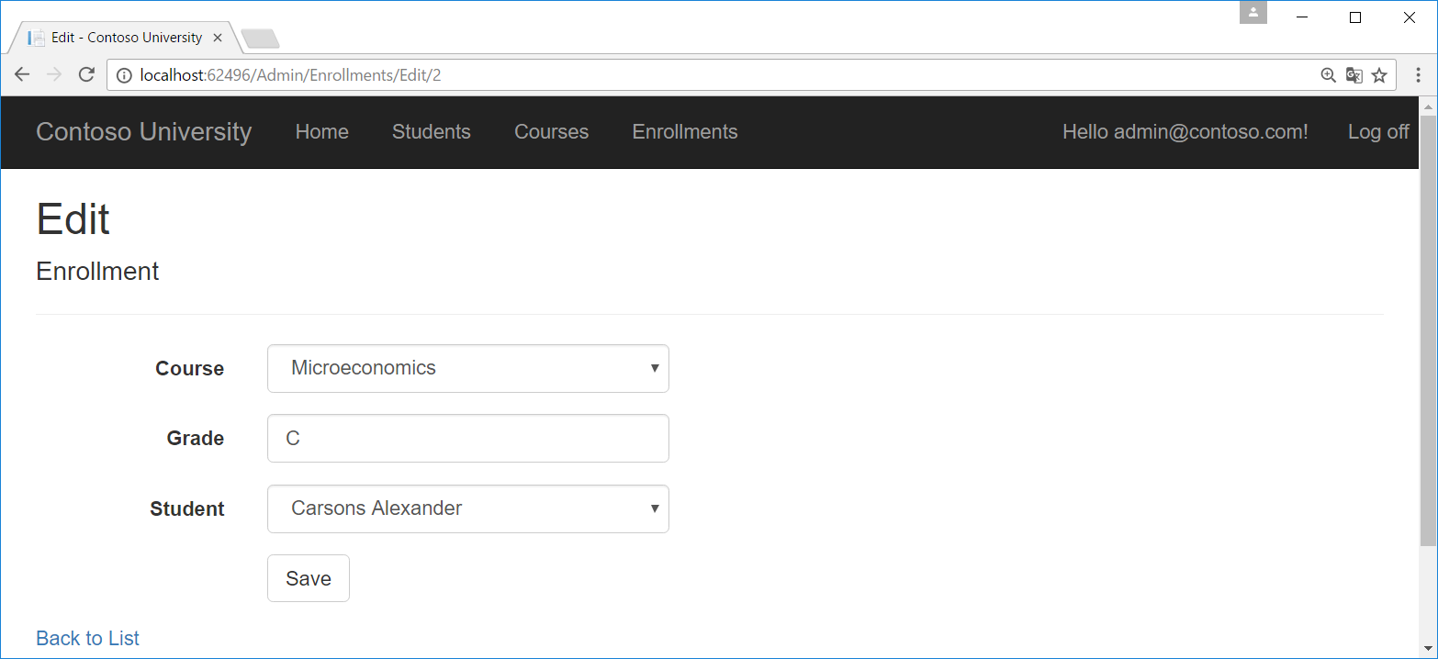
Edit Enrollment (idem voor create)

Slide 31
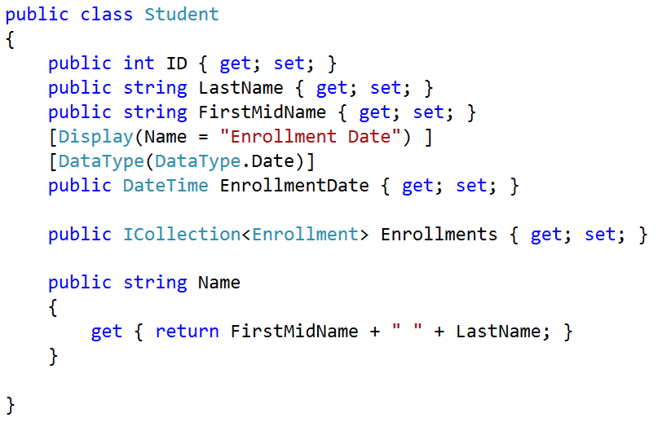
Student.cs

Slide 32
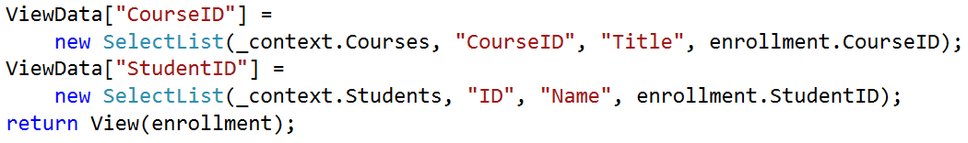
EnrollmentsController.cs (Edit)
2x (bij Get en Post)

Slide 33
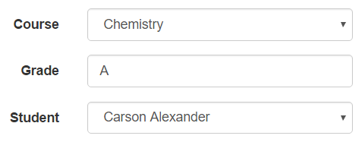
Edit.cshtml (idem voor create)
<label asp-for="CourseID" class="control-label col-md-2">
@Html.DisplayNameFor(model => model.Course)
</label>
<label asp-for="StudentID" class="control-label col-md-2">
@Html.DisplayNameFor(model => model.Student)
</label>

